Slide 1



Aircraft Schedule Recovery Problem Using Deep earning and Machine Learning
Under the guidance of professor Gautam Sen

Slide 2
Introduction
Airlines dedicate considerable time, resources, and effort to network planning and scheduling, aiming to maximize the use of their vital assets like aircraft, crew, and ground facilities. Despite these meticulous efforts, unforeseen circumstances and various external factors can disrupt even the most well-crafted plans. Disruptions such as adverse weather, airport shutdowns, mechanical failures, and security holdups can occur unexpectedly. These incidents can drastically compromise previously optimized schedules, sometimes rendering them ineffective or impossible to follow. Such disruptions not only affect an airline's profitability but also inconvenience passengers and have broader economic implications. Airlines actively monitor their flight operations to manage and lessen the impact of disruptions on their schedules, a process known as disruption management. Given the complexity and magnitude of real-world airline disruption scenarios, these issues are typically broken down and addressed sequentially. This approach involves dividing the larger problem into smaller, more manageable sub-problems to be solved one by one. Due to the need for swift solutions, achieving exact answers for even these smaller issues is often impractical within the limited time available. In addressing these disruptions, airlines usually prioritize the Aircraft Recovery Problem (ARP) before turning their attention to crew and passenger recovery. During ARP, various strategies are employed, such as swapping aircraft, delaying or cancelling flights, and altering flight routes (Barnhart and Vaze, 2015). Hence it becomes of key importance to identify key flights that will be affected by a disruption and its schedule that is needed to be managed.

Slide 3
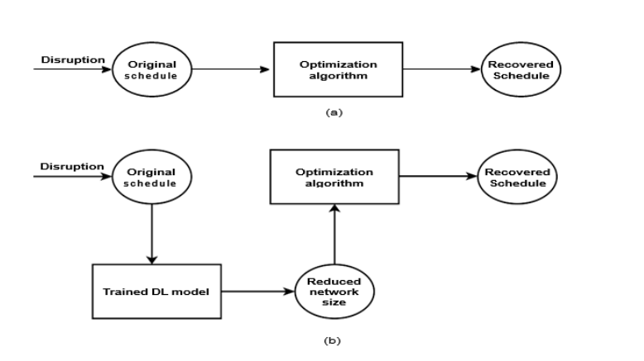

To rectify a disturbed schedule, a set of aircraft, termed 'key aircraft,' undergo rescheduling, which includes delays and flight cancellations. Meanwhile, 'non-key aircraft' continue to follow their original schedules. Deep learning is tasked with forecasting a streamlined subset of the network by excluding non-key aircraft. This subset is then integrated into the optimization algorithm, diminishing the time needed for computation while maintaining the integrity of the solution. In contrast, optimization processes that do not utilize deep learning have to process the full fleet, leading to prolonged computational times. Deep learning harnesses data from previously rectified schedules to train models in an offline setting. Although preparing the training dataset is labor-intensive, it is an investment that promises to significantly cut down the time required by the optimization algorithm to adjust future schedules in light of disruptions.

Slide 4

Research Gap: Most of the Researchers have tried Machine Learning approaches to solve the ASRP very few or none have tried Deep Learning Approach as it requires a huge amount of dataset and is usually complex and hard to explain how and why it gives better results. Deep learning has capabilities to predict better and hence give accurate results that will prune the solution space for optimization and then compare it with other machine learning models to get a qualitative idea which is a better approach a
Objective: To prune the problem space by identifying subnetwork of aircrafts (key aircrafts) using deep learning models and compare with machine learning models. nd has more scope for research.

Slide 5
Dataset
Total 7 original schedule contains approx. 150 flights each, Made 5 intervals for disruption window of 324 mins (assumed 1 day is of 27hrs)
Total 1800 optimal schedule after disruption of aircrafts
Features of Schedule
Flight id
Aircraft Name
Departure Airport
Departure Time
Arrival Airport
Arrival Time

Slide 6
Feature Extraction and preprocessing
In the realm of neural network modelling, particularly when dealing with categorical data such as aircraft names, the transformation of these names into a machine-understandable format is not just beneficial but essential. This transformation is adeptly accomplished through the process of one-hot encoding. One-hot encoding is a pivotal method in data preprocessing, especially for neural network models, as it converts categorical variables into a binary matrix representation.
Another feature that was selected was the disruption time. The data available was of optimal schedules and the time, airport and aircraft of disruption had to be extracted from the schedule. Moreover the optimal schedule time and original schedule time was not in the same format and hence was 1st converted to same format after extraction of time and then subtraction of original schedule time and optimal schedule time of the disrupted aircraft was done to obtain the disruption duration column.

Slide 7
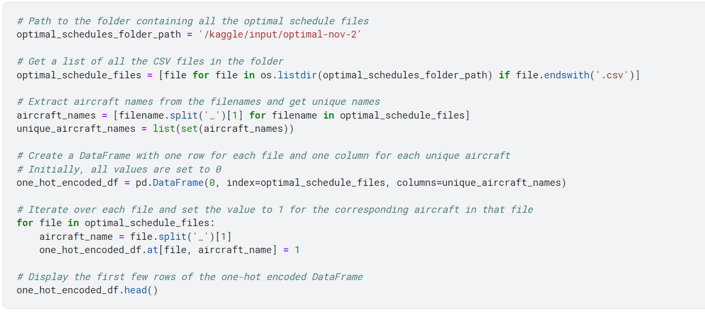
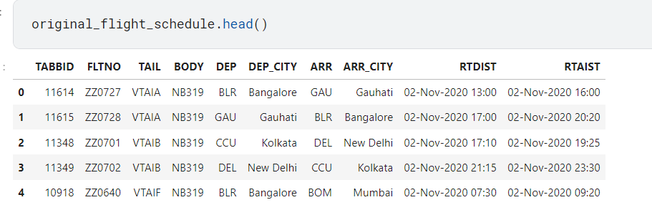
Extraction of Aircraft name and since it is in string format we do one hot encoding to change it to numerical data to feed in any model

Slide 8
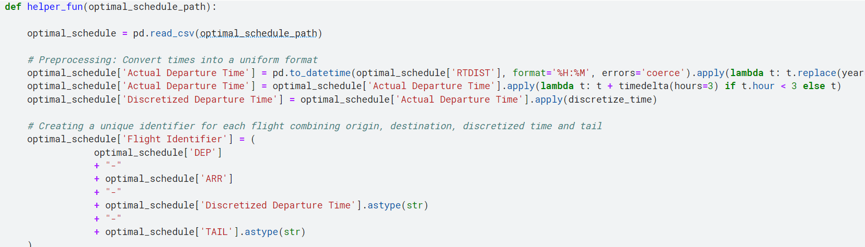
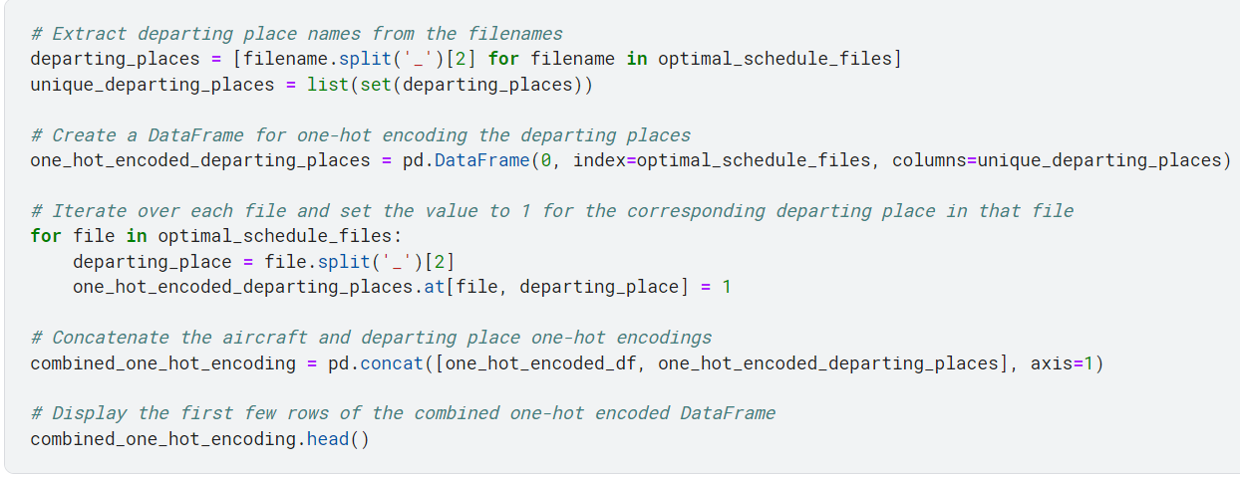
Changing time of all schdelues into standard format
Extraction of Departure place and then one hot encoded

Slide 9
Feature Engineering
Discrtization of time into 30 mins intervals
Arrival airport+departure airport+departure time
Unique Flight Identifier
Extraction of Disruption time
UFI as labels

Slide 10
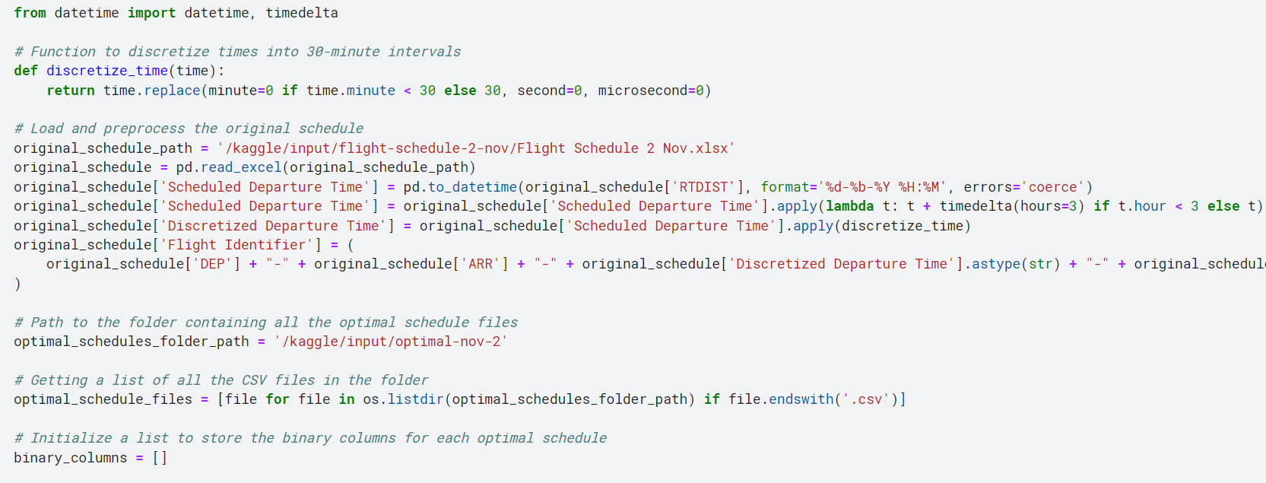
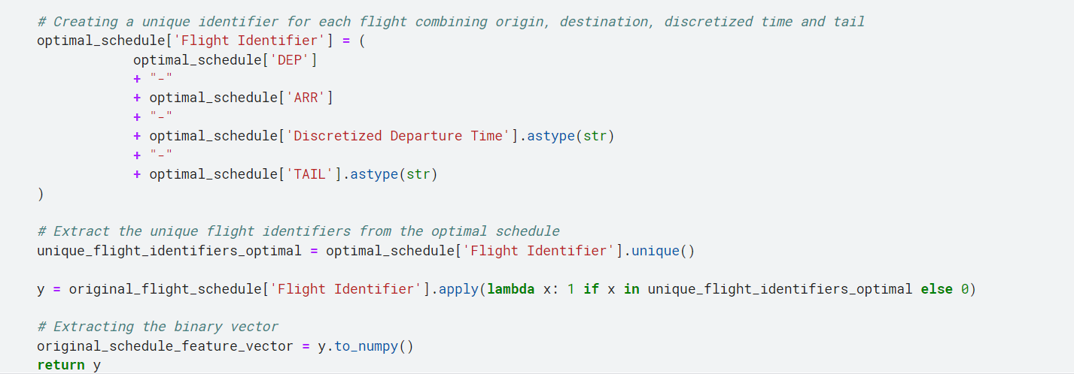
Discretization of Time
Creation of Unique Flight Identifiers

Slide 11
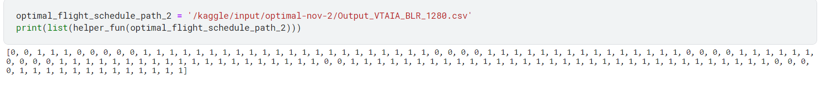
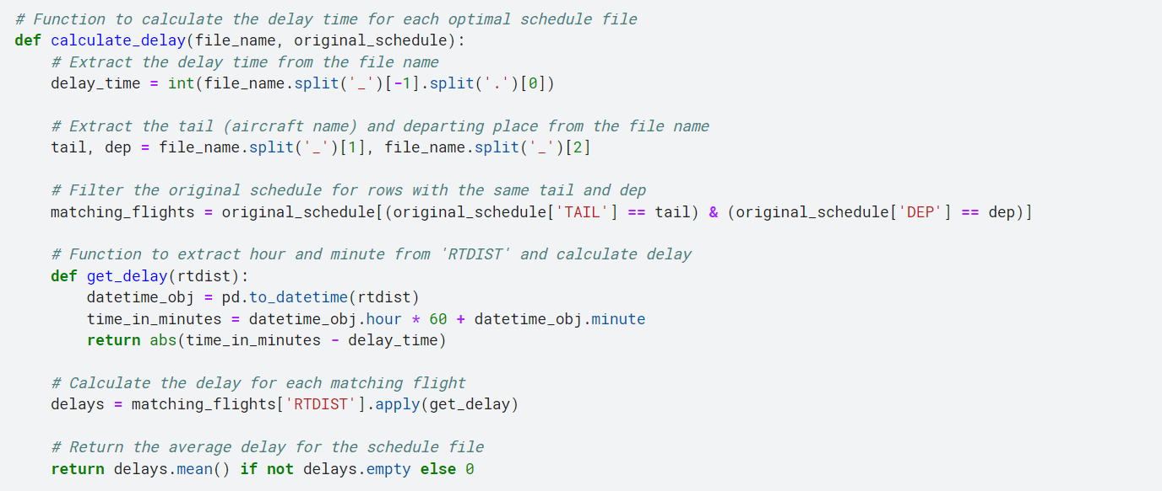
Y Label
Delay Time Calculation

Slide 12
Methods
Data Splitting (80:20)
136 MLP Classifiers trained to predict 136 labels to identify key aircraft
Each model 2 deep layers with 126 and 64 neurons respectively
Logistic Regression to predict class
Random Forest to predict Class
Evaluation of precision and Recall to compare

Slide 13
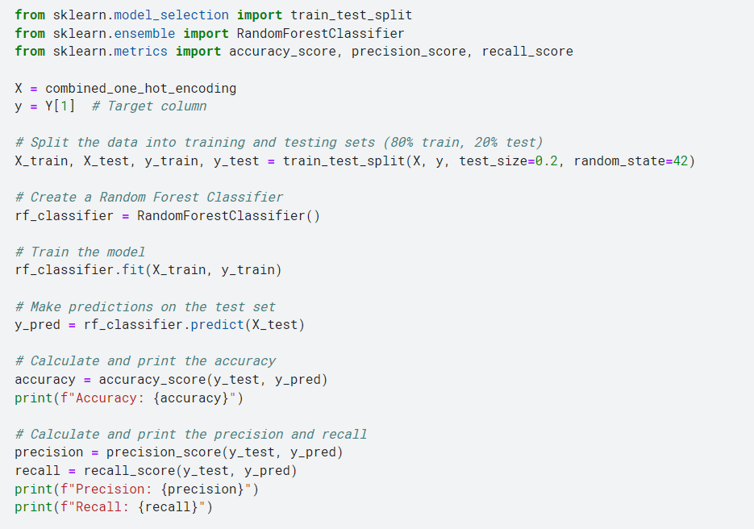
Random Forest Classifier
Data split
Creating random forest
Training
Prediction
Evaluation metrices

Slide 14
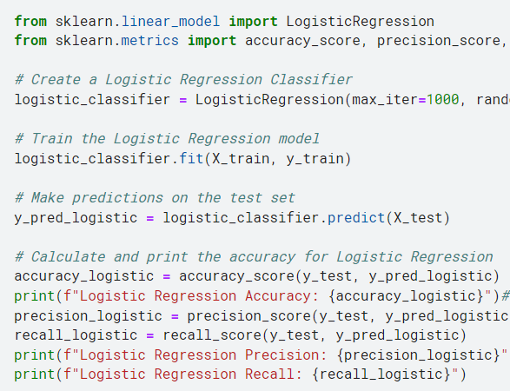
Logistic Regression
Creating logistic model with max iterations 1000
Training
Testing
Evaluation metrices

Slide 15
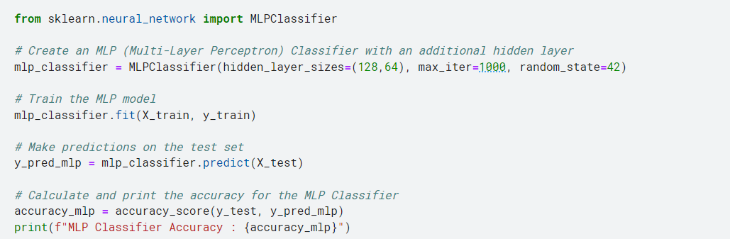
MLP Classifier
One Classifier trained 136 almost similar classifier with 2 hidden layer using feed forward
Testing
Evaluation Metrices

Slide 16
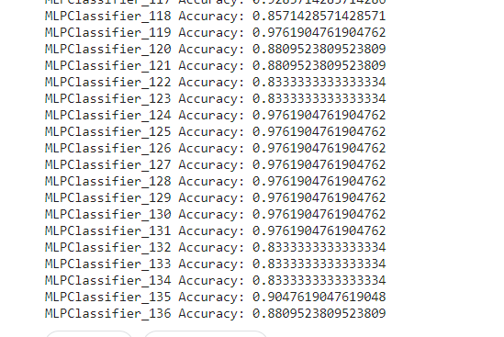
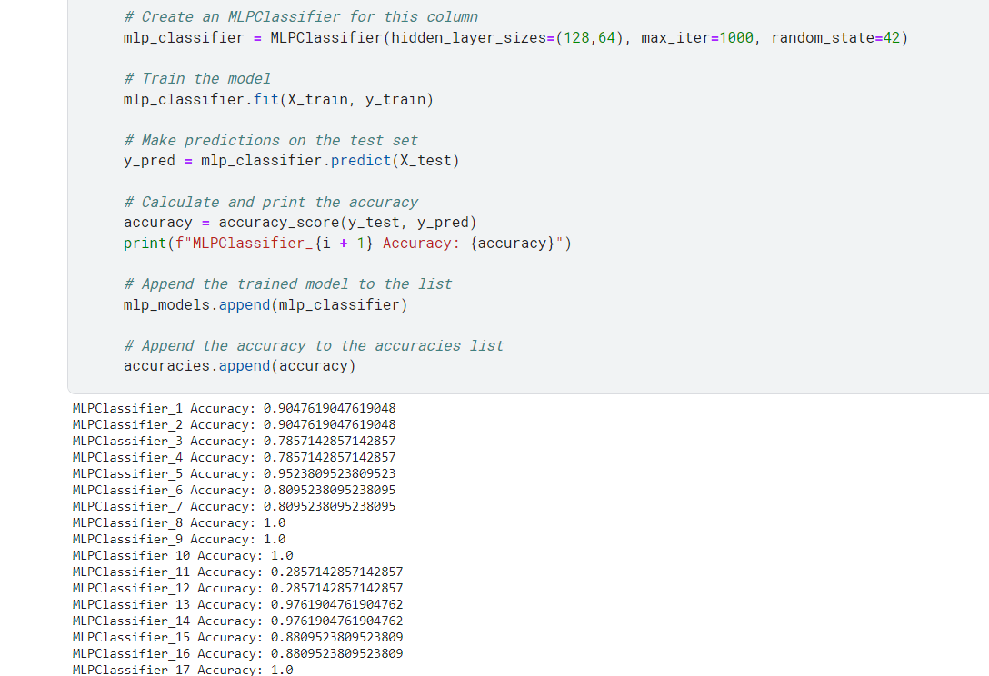
Average 0.908 accuracy of all MLP Classifiers

Slide 17
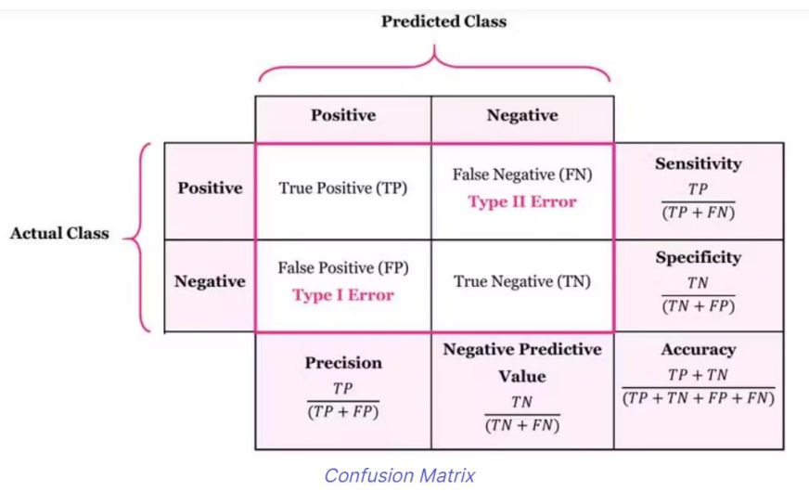
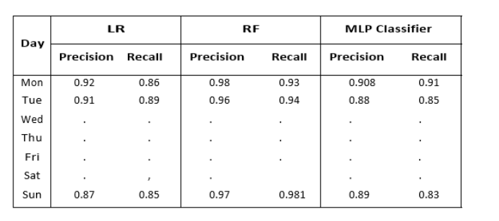
The results from applying Logistic Regression, Random Forest, and Multi-Layer Perceptron (MLP) classifiers to the Aircraft Schedule Recovery Problem (ASRP) offer intriguing insights into the efficacy of these models in a complex, real-world scenario. Logistic Regression exhibits a commendable precision of 0.92, indicating its strong ability to correctly identify disrupted flights. This high level of precision suggests that Logistic Regression, despite its relative simplicity, is quite adept at handling linear relationships within the dataset. In contrast, the Random Forest classifier achieves an even higher precision of 0.98, underscoring its superiority in handling the intricacies of the ASRP. The ensemble nature of Random Forest, which aggregates predictions from multiple decision trees, contributes to its robust performance. This methodology effectively captures the diverse and variable factors influencing flight disruptions, leading to more accurate predictionsThe MLP Classifier, with an average precision and recall of 0.908, showcases its capability to model complex, non-linear relationships in the ASRP data. The highest precision recorded at 0.9998 demonstrates the MLP's potential to achieve near-perfect accuracy under certain conditions. However, the lowest precision of 0.67 reflects variability in its performance, likely due to the diverse and complex nature of the data and the model's sensitivity to different data distributions and features

Slide 18
Future Scopes
Enhancing Data Quality and Volume
Enhanced data quality
Advanced Feature Engineering
Experimenting with Hybrid Models
Improving Real-Time Predictive Capabilities
Robustness to Data Anomalies and External Factors
User-Friendly Implementation and Integration with Existing Systems
Ethical and Environmental Considerations

Slide 19
Link to NoteBook

Slide 20


Thank You

